Slide 1

An analysis on Disaster Management Tweets and their Relevancy BIA 660-A: Web Mining
Group 3:
Chinmay Bhagwat (20015512)
Prachi Jacob (20011215)
Manoj Patel (20012221)

Slide 2
Problem Statement
In the context of Twitter's crucial role in disseminating disaster-related information, the project aims to enhance the accuracy of alerts by distinguishing real data from casual language often misinterpreted by the platform's algorithms. Leveraging Machine Learning and data from Twitter, the objective is to improve disaster management through the identification of genuine information and trends in keyword usage.

Slide 3
OVERVIEW
Data Collection: Gathering a comprehensive data on disaster from Twitter (X)
Data Preprocessing: Performing data preprocessing tasks like cleaning, normalization, and feature selection
Explanatory Data Analysis: Analyzing and visualizing the data to understand patterns and distributions
Data Modeling (NLP)
Model Testing and Result: Evaluating the NLP model with the testing data
Conclusion: Assessing the results and implications

Slide 4
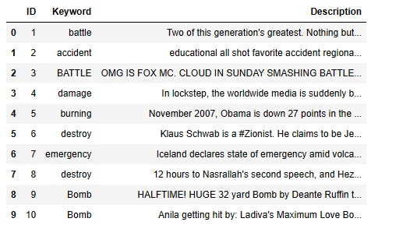
Data Collection
Training Data: Collected data from Kaggle website
Testing Data: Collected the latest data by scraping Twitter feeds for the model testing
Advanced Search: Used 100 keywords related to disaster(accident, dead, tornado, wildfire, earthquake, etc.) using the advanced filter “Any of these words”
Tried extracting data from 500 tweets

Slide 5
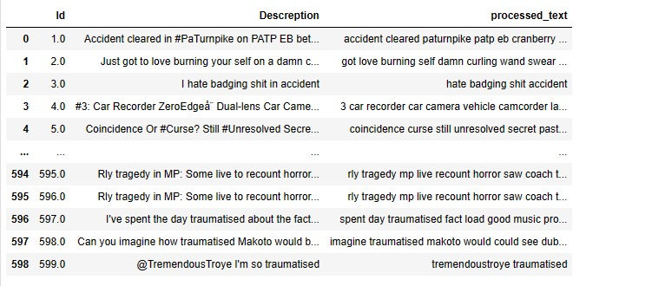
Data Cleaning
The data descriptions scraped from Twitter were tokenized to facilitate further analysis
Characters in the text such as “,”, “.”, “;”, etc. were cleaned from the tokenized descriptions to ensure consistency and improve text data quality
The top 10 stop words as shown in the graph were removed to focus on more meaningful words

Slide 6
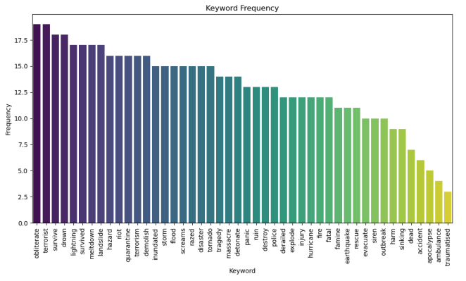
Explanatory Data Analysis

Slide 7
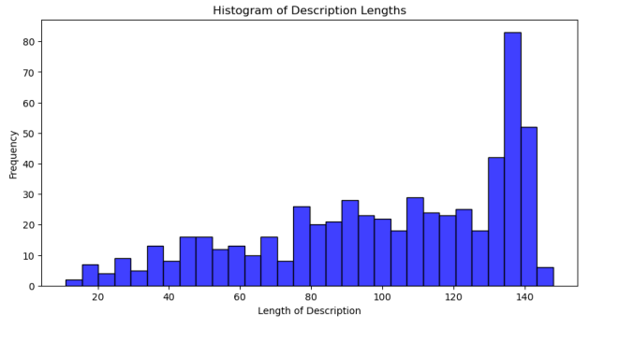
Explanatory Data Analysis

Slide 8
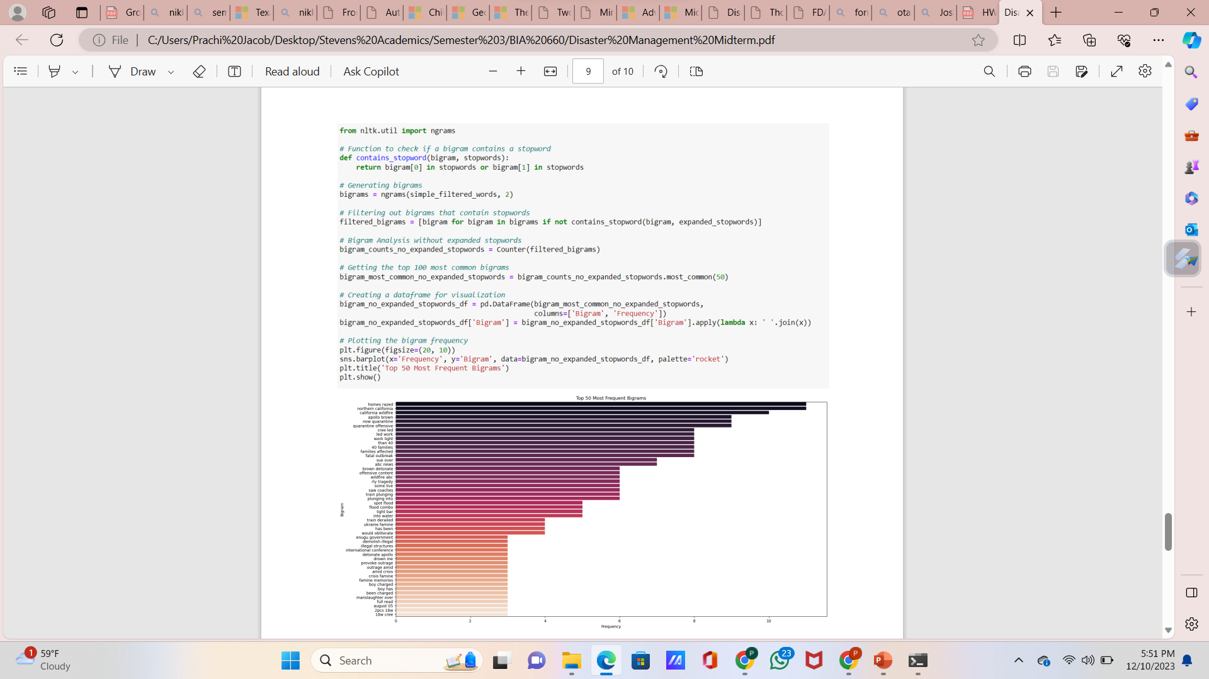
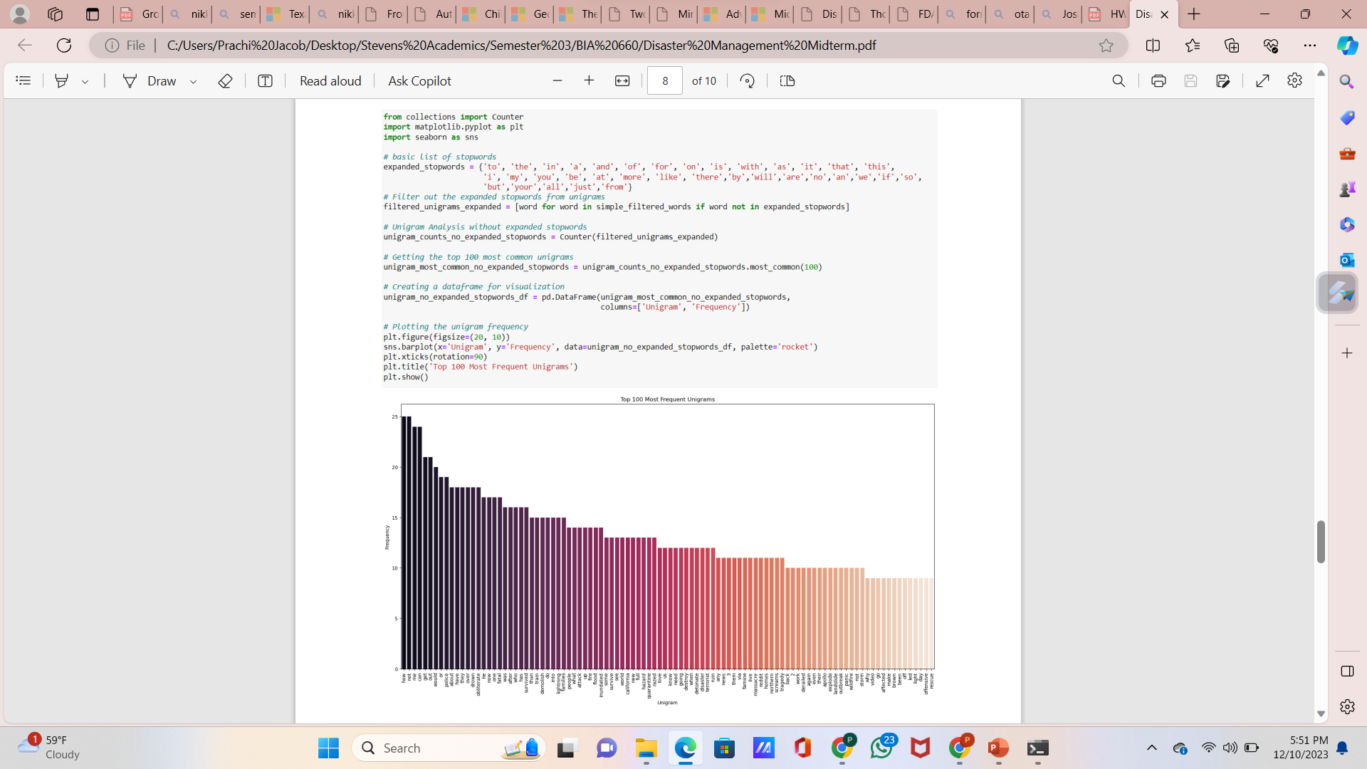
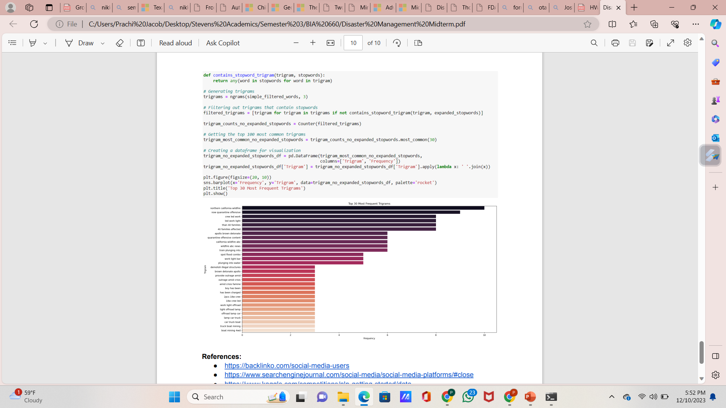
Explanatory Data Analysis

Slide 9
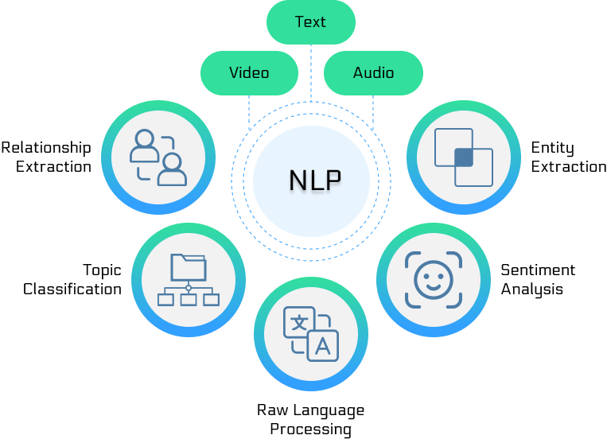
Data modeling – natural language processing
Exploring Language: NLP, or Natural Language Processing, enables machines to understand, interpret, and respond to human language effectively.
Machine Learning Integration: NLP combines computational linguistics and machine learning to process and analyze large volumes of natural language data.
Application Diversity: NLP is widely used in applications like language translation, sentiment analysis, and chatbots for enhanced user interaction.
Technological Evolution: Continuous advancements in NLP are driving better context understanding and more natural human-computer interactions.
Data Analysis Tool: NLP plays a crucial role in text mining and extracting meaningful information from unstructured data sources.

Slide 10
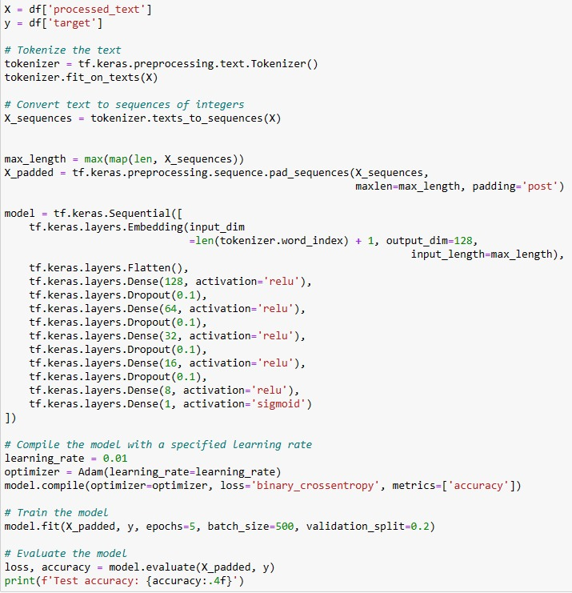
Data modeling – natural language processing
Implementation:
Tokenization: Utilizes Keras Tokenizer to map words to integers, essential for NLP modeling.
Padding: Standardizes sequence lengths post-tokenization, preparing consistent input for the neural network.
Model Architecture: The model is a deep neural network comprising an embedding layer, several dense layers with ReLU activations, dropout layers to reduce overfitting, and a final dense layer with a sigmoid activation function for binary classification.
Training Process: Trains the deep learning model with specified epochs, batch size, and validation split.
Performance Evaluation: Assesses accuracy and loss of the NLP model on test data post-training.

Slide 11
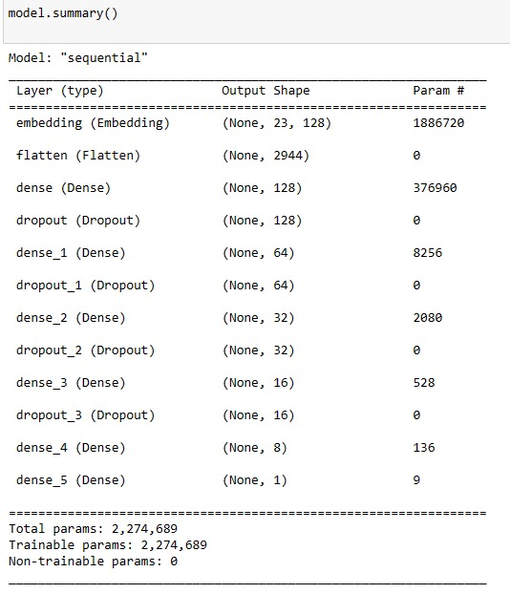
Data modeling – natural language processing
Summary
Model Type: Sequential, indicating a linear stack of layers.
Embedding Layer: The first layer is an embedding with 1,886,720 parameters, suggesting a large vocabulary size.
Flatten Layer: A flattening layer is used to reshape the output from the embedding for the dense layers, with no additional parameters.
Dense Layers: Multiple dense layers are present with varying numbers of neurons (128, 64, 32, 16, 8, 1) and use ReLU activation, except the last one which uses a sigmoid activation function for binary classification.
Dropout Layers: Several dropout layers with a rate of 0.1 are interspersed among the dense layers to help prevent overfitting by randomly setting a fraction of input units to zero during training.
Output Layer: The final dense layer outputs a single value with a sigmoid activation function, suitable for binary classification tasks.

Slide 12
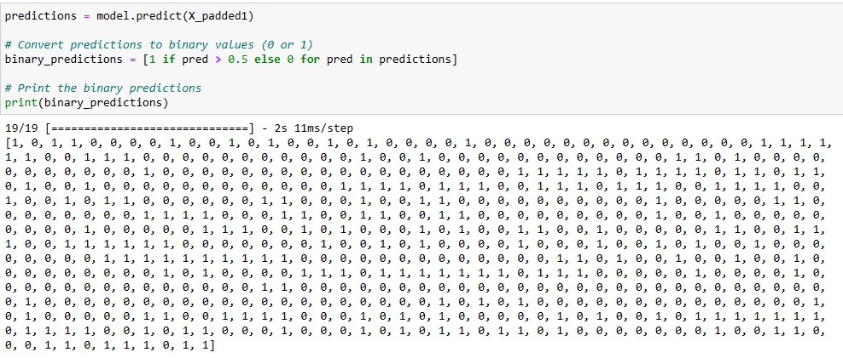
Model testing and result
Model was tested using Twitter data that was obtained through scraping using keywords
Target values of the textual data are as seen in the corresponding image
Model exhibited a high and impressive accuracy of 93%

Slide 13
conclusion
Our goal for this project was to classify the relevant data from the irrelevant Twitter posts and address the challenge of enhancing accuracy and relevancy of disaster-related tweets/alerts
Remarkable outcome of 93% accuracy signifies advancement in distinguishing genuine information from casual language often misinterpreted by Twitter’s algorithm
Future implementations for improving disaster management by providing more precise information on social media during a crisis

Slide 14
THANK YOU

